Slide 1
Predictive Analysis for Big Mart Sales Using Machine Learning Algorithms

Slide 2
ABSTRACT
Currently, supermarket run-centres, Big Marts keep track of each individual item's sales data in order to anticipate potential consumer demand and update inventory management. Anomalies and general trends are often discovered by mining the data warehouse's data store. For retailers like Big Mart, the resulting data can be used to forecast future sales volume using various machine learning techniques like big mart. A predictive model was developed using Decision Tree Regression for forecasting the sales of a business such as Big -Mart, and it was discovered that the model outperforms existing models.

Slide 3
EXISTING SYSTEM
Auto-Regressive Integrated Moving Average, (ARMA) Auto-Regressive Moving Average, have been utilized to develop a few deals forecast standards. Be that as it may, deals anticipating is a refined issue and is influenced by both outer and inside factors, and there are two significant detriments to the measurable technique as set out in A. S. Weigend et A mixture occasional quantum relapse approach and (ARIMA) Auto-Regressive Integrated Moving Average way to deal with every day food deals anticipating were recommend by N. S. Arunraj and furthermore found that the exhibition of the individual model was moderately lower than that of the crossover model.

Slide 4
E. Hadavandi utilized the incorporation of “Genetic Fuzzy Systems (GFS)” and information gathering to conjecture the deals of the printed circuit board. In their paper, K-means bunching delivered K groups of all information records. At that point, all bunches were taken care of into autonomous with a data set tuning and rule-based extraction ability.

Slide 5
Perceived work in the field of deals gauging was done by P.A. Castillo, Sales estimating of new distributed books was done in a publication market the executives setting utilizing computational techniques. “Artificial neural organizations” are additionally utilized nearby income estimating. Fluffy Neural Networks have been created with the objective of improving prescient effectiveness, and the Radial “Base Function Neural Network (RBFN)” is required to have an incredible potential for anticipating deals.

Slide 6
DISADVANTAGES OF EXISTING SYSTEM
Complex models like neural networks are overkill for simple problems like regression.
Existing system models prediction analysis which gives less accuracy.
Forecasting methods and applications contains Lack of Data and short life cycles. So some of the data like historical data, consumer-oriented markets face uncertain demands, can be prediction for accurate result.

Slide 7
PROPOSED SYSTEM
The objective of this proposed system is to predict the future sales from given data of the previous year's using Decision Tree Regression
Another objective is to conclude the best model which is more efficient and gives fast and accurate result by using Decision Tree Regression.
To find out key factors that can increase their sales and what changes could be made to the product or store's characteristics.

Slide 8
Experts also shown that a smart sales forecasting program is required to manage vast volumes of data for business organizations.
We are predicting the accuracy for Decision Tree Regression. Our predictions help big marts to refine their methodologies and strategies which in turn helps them to increase their profit. The results predicted will be very useful for the executives of the company to know about their sales and profits. This will also give them the idea for their new locations or Centre’s of Bigmart

Slide 9
ADVANTAGES OF PROPOSED SYSTEM
Business assessments are based on the speed and precision of the methods used to analyze the results. The Machine Learning Methods presented in this research paper should provide an effective method for data shaping and decision-making.
New approaches that can better identify consumer needs and formulate marketing plans will be implemented.

Slide 10
The outcome of machine learning algorithm will help to select the most suitable demand prediction algorithm and with the aid of which BigMart will prepare its marketing campaigns.

Slide 11
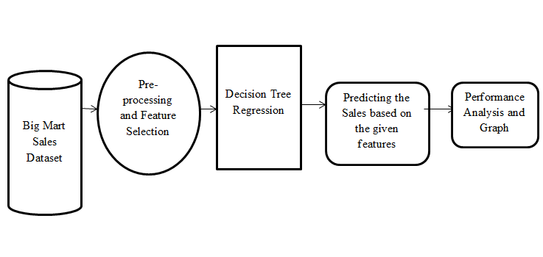
SYSTEM ARCHITECTURE

Slide 12
HARDWARE REQUIREMENTS
System : Pentium i3 Processor.
Hard Disk : 500 GB.
Monitor : 15’’ LED
Input Devices : Keyboard, Mouse
Ram : 4 GB

Slide 13
SOFTWARE REQUIREMENTS
Operating system : Windows 10.
Coding Language : Python
Web Framework : Flask

Slide 14
REFERENCE
Ranjitha P, Spandana M, “Predictive Analysis for Big Mart Sales Using Machine Learning Algorithms”, IEEE Conference, 2021.

